Slide 1

Skin Cancer Classification
By Kristof Vandewynckel
Junior Data Scientist/ AI Operator @ BeCode

Slide 2
Overview
Skin cancer in our current society.
Mission statement.
7 classes of skin cancer.
Process.
Demo.
What’s next?

Slide 3
Some numbers
General rise in numbers, estimated 3,4 million US citizens will be diagnosed with skin cancer in 2022.
One in five US citizens will develop skin cancer by the age of 70.
An estimated 2 people die every hour due to skin cancer in the US.
When detected early ,the survival rate for melanoma is 99%
UV seems to be the most common cause.

Slide 4
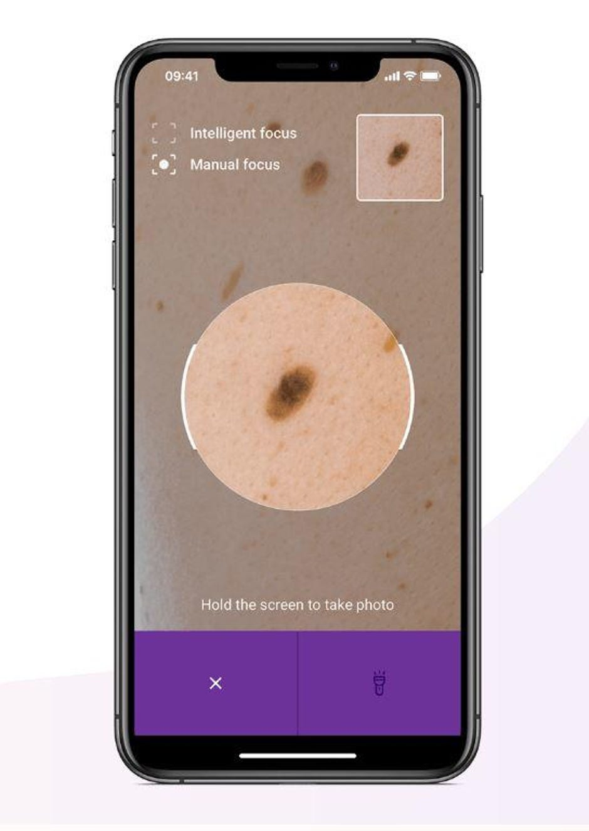
Mission statement
Create an app that could determine, based on a smartphone picture, whether a mole was a cancerous or not.
A database of 10.015 images.
Timespan: 8 days for a Minimum Viable Product.

Slide 5
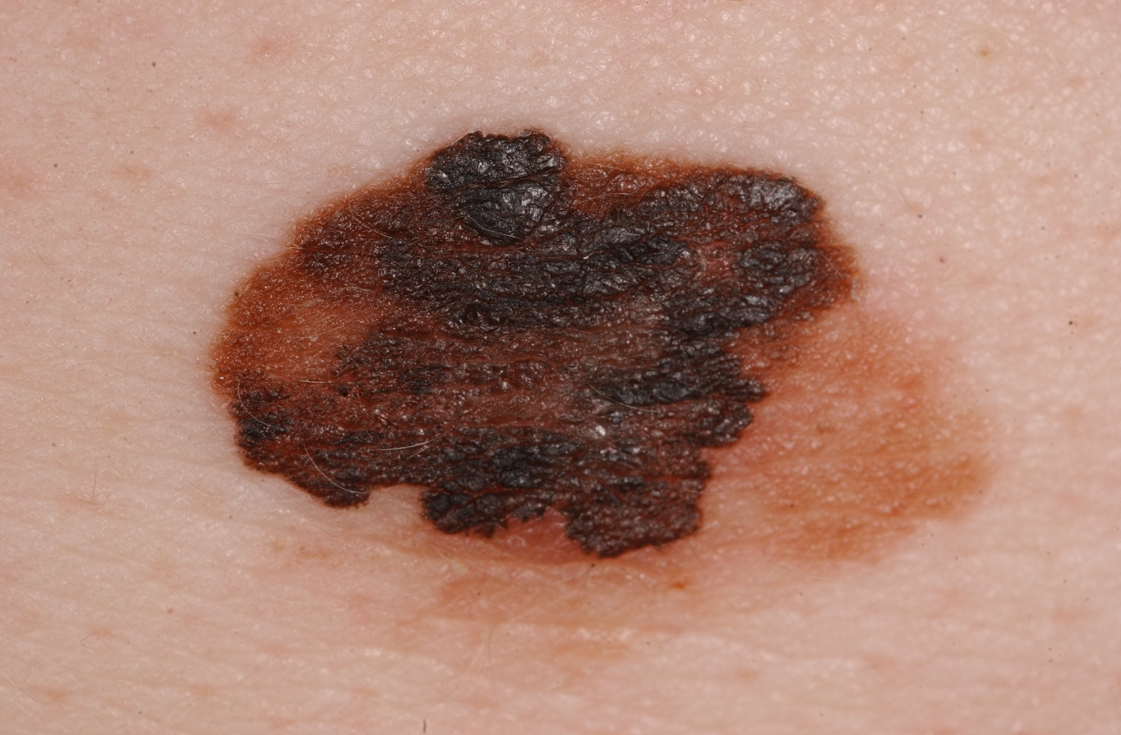
7 classes of skin cancer
Our app needs to recognize and identify any moles in the uploaded picture. It then has to classify these as one of the following.
Actinic keratoses
Basal cell carcinoma
Benign keratosis-like lesions
Dermatofibroma
Melanoma (pictured)
Melanocytic nevi
Vascular lesions

Slide 6
Process
First the user takes a picture with their smartphone and uploads it to our app on Heroku. https://mole-detection-app.herokuapp.com/ (Under construction)
Created a Convolutional Neural Network (CNN) that is applied to the picture. (currently 82% accuracy on test data).
CNN gives back the classification with the highest percentage and added information, suggesting if a medical follow-up is wise.

Slide 7
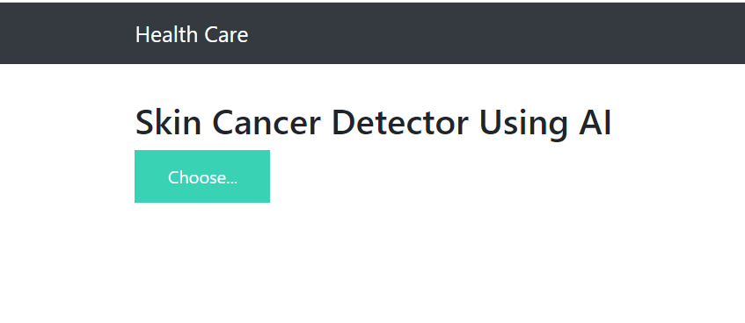
Demo

Slide 8
What’s next?
Still some issues due to limited time. What I intend to fix/resolve:
To have a fully working prototype:
Fix issue where majority of class is often predicted.
Add descriptions of classifications and suggestions.
Deploy a fully working app on heroku.
To improve upon the accuracy of the classification:
Collect/create more data to balance the dataset.
Improve the accuracy.

Slide 9


Thank you for your attention! Any questions?
https://www.linkedin.com/in/kristof-vandewynckel/
https://github.com/KristofVandewynckel

